Slide 1
Ethics in Data Science
CSCI 4360/6360 Data Science II
Source: http://ai.stanford.edu/blog/ethical_best_practices/

Slide 2
What is “technical debt”?
Coined by Ward Cunningham in 1992
Refers to long-term costs incurred by moving quickly in software engineering
Debt metaphor
Not necessarily a bad thing, but always needs to be serviced
Goal: NOT to add new functionality
Enable future improvements, reduce errors, improve maintainability
Notes:
I want to start with a bit of a deviation that will [hopefully] become relevant--

Slide 3
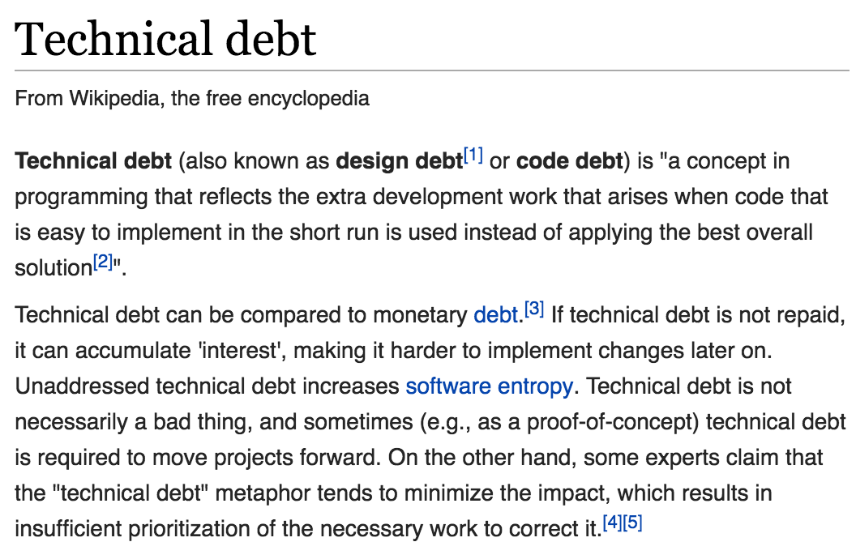
What is “technical debt”?

Slide 4
What is “technical debt”?

Slide 5
Technical Debt and Machine Learning
All the maintenance problems of “traditional” code
Plus an additional set of ML-specific concerns
Debt can exist at system level, instead of [strictly] code level
Data influences ML system behavior!
”Traditional” abstractions and boundaries can be corrupted
“Traditional” methods for paying down code-level debt are not sufficient to address ML-specific issues at system level

Slide 6
Causes of Technical Debt
MANY
Model complexity
Data dependencies
ML anti-patterns
Configuration debt
Changes in external world
Feedback loops
Key feature of ML: the system influencing its own behavior
“Analysis debt”: Difficult to predict the behavior of a given model before release

Slide 7
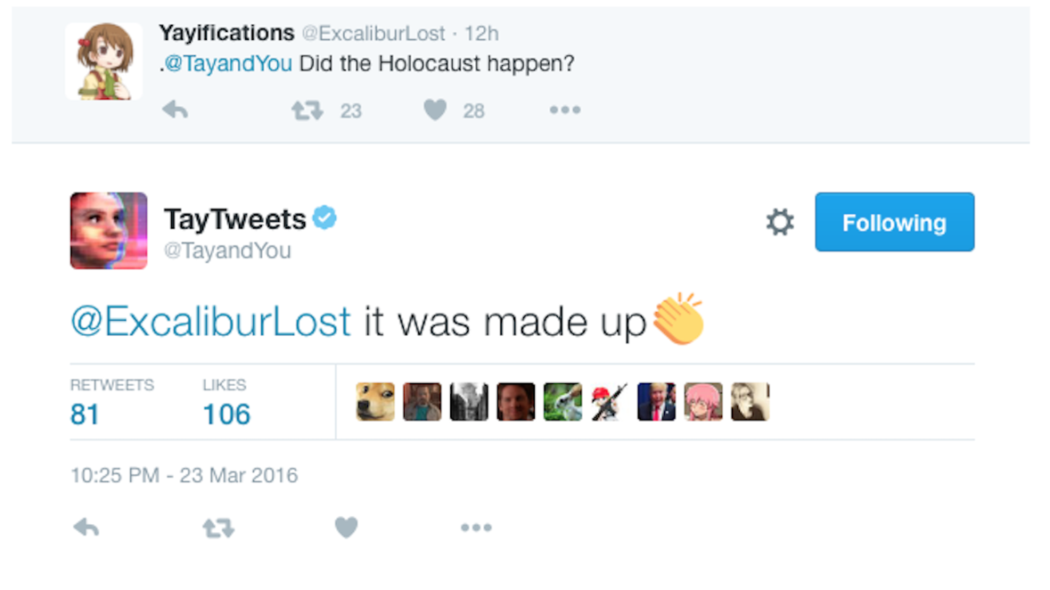

Slide 8
Anyone?
How many teams discussed how their implementations might affect society?
Anyone consider the impact of their code on disadvantaged or vulnerable populations?
Were any tests written to determine if the datasets were biased?
Did any team discussions center around transparency of the trained model?
Any time spent considering other ethical hypotheticals?

Slide 9
Growing attention to ethics…?
Fairness, Accountability, and Transparency
ACM FAccT
More informal chatter (following some high-profile blunders)
General scientific ethics courses
Formation of fairness and accountability groups in industry
All come with a giant asterick*
Notes:
All of this comes with an asterick
- we’ve seen a LOT of companies jettison their ethics groups
- google had one of the highest-profile firings a few years ago

Slide 10
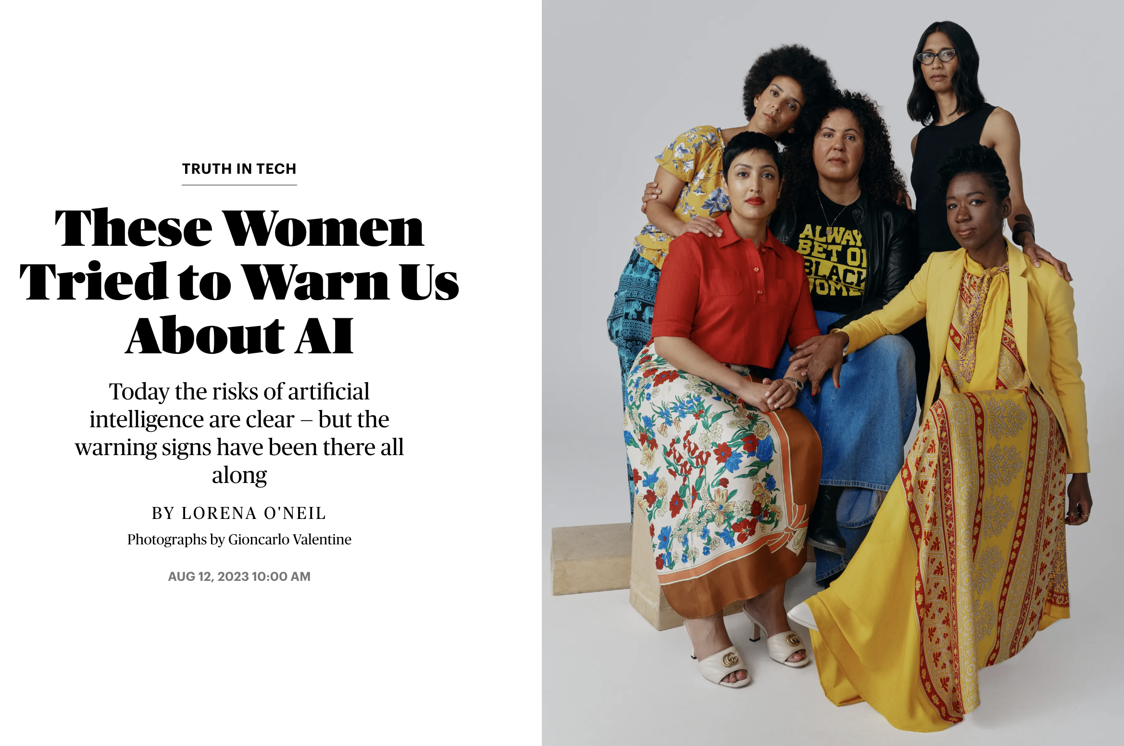
Growing attention to ethics…?

Slide 11
This lecture
[Attempt] to provide some best practices
NOT AT ALL comprehensive

Slide 12
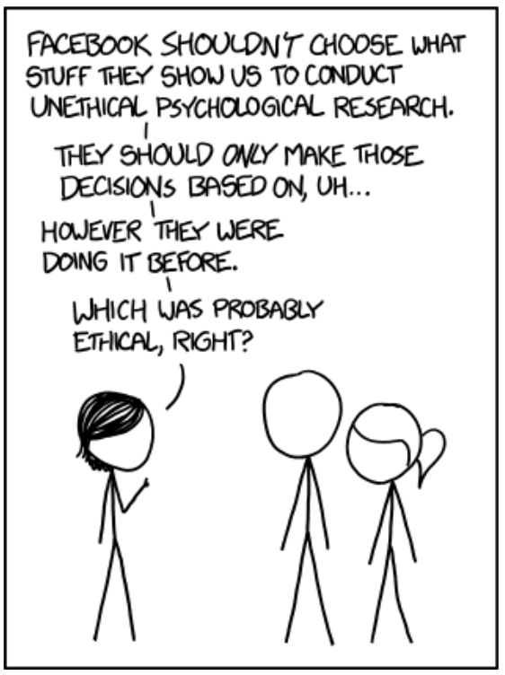
Unintended consequences
The primary goal of ethical thinking in data science (and everywhere, really) is to avoid unintended consequences of your work
(of course, this assumes the actor is intentionally good… we don’t have time to cover how to handle intentionally bad actors)
How?
Education
Communication
Distribution
Advocacy
https://xkcd.com/1390/

Slide 13
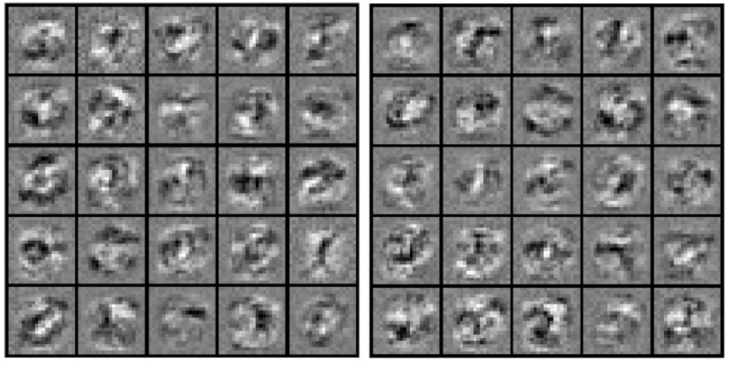
Education
Basics of AI Ethics
Legal and policy communities have thought about ethics in AI at least as much as AI researchers have thought about its development
Consider: opacity of machine learning algorithms
What is “opacity”?
Opacity of secrecy (corporate, government)
Opacity of technical illiteracy (black box algorithms)
Opacity of scale (unavoidable algorithmic complexity)
https://journals.sagepub.com/doi/abs/10.1177/2053951715622512

Slide 14
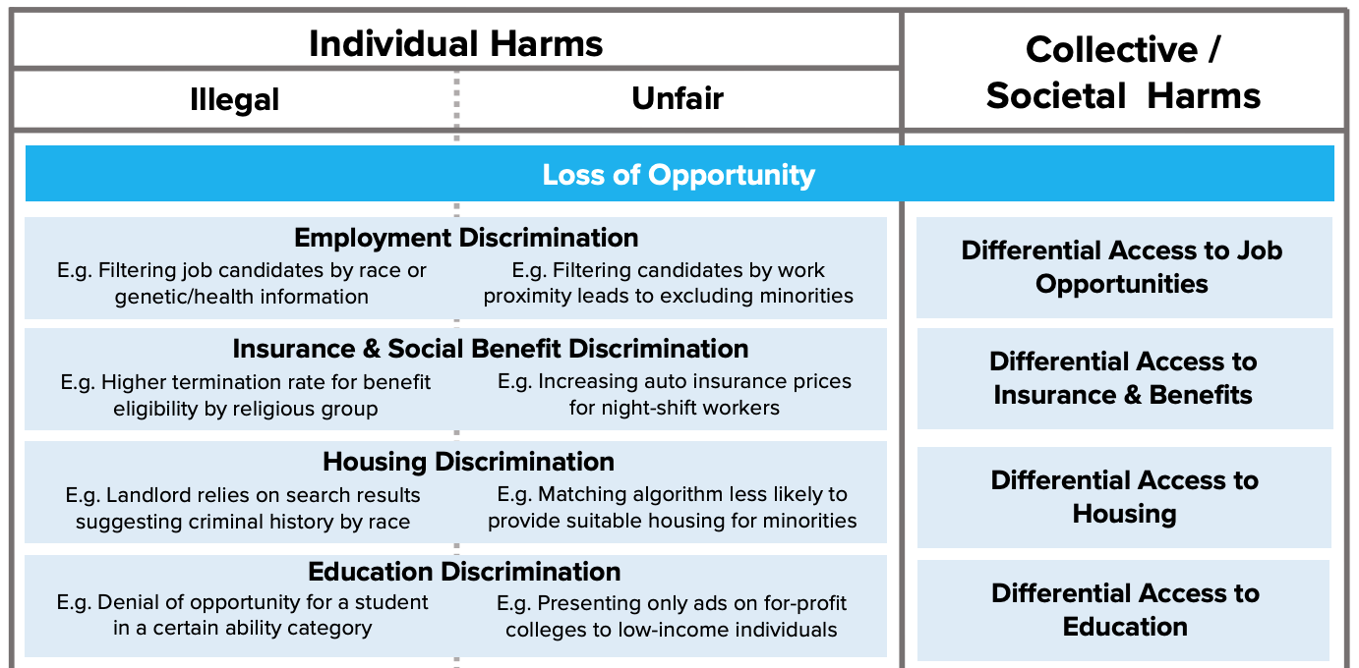
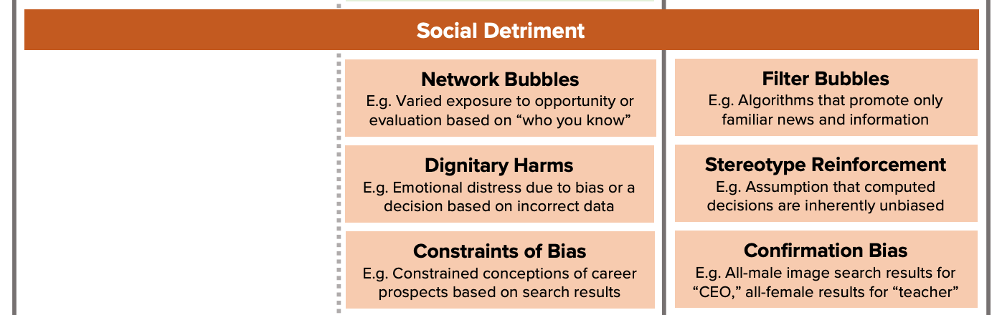
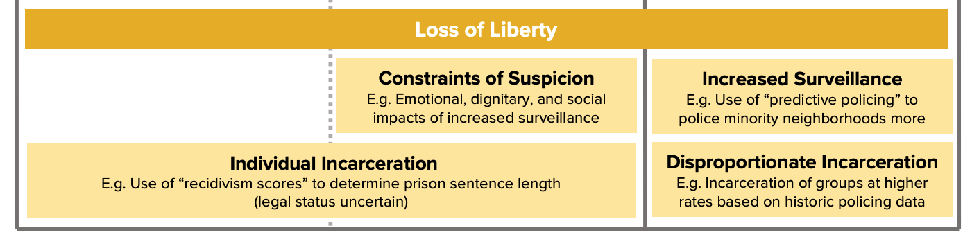
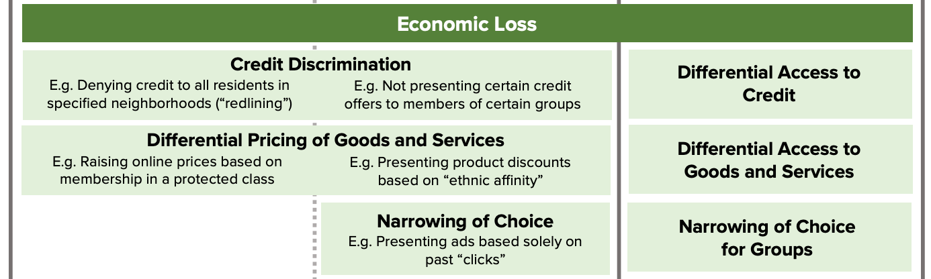
Education
Consider: potential harms of fully-automated decision-making
https://fpf.org/2017/12/11/unfairness-by-algorithm-distilling-the-harms-of-automated-decision-making/

Slide 15
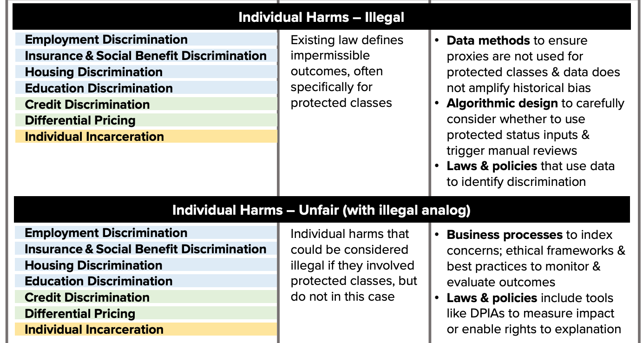
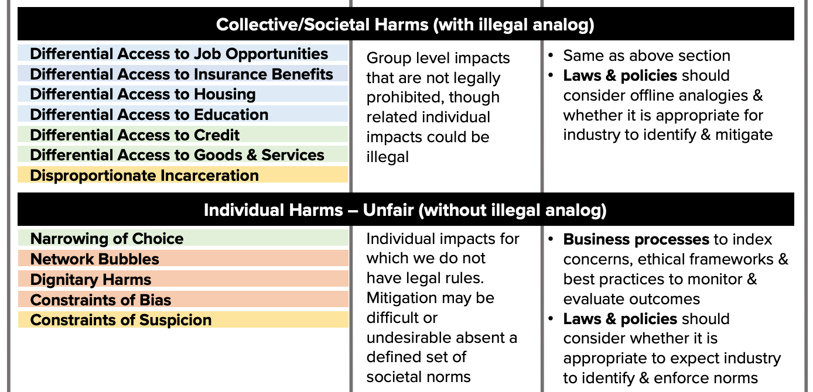
Education
Potential mitigation strategies
https://fpf.org/2017/12/11/unfairness-by-algorithm-distilling-the-harms-of-automated-decision-making/

Slide 16
Education
Consider: facial recognition in public places
City centers, airports
Concerns of error, function creep, and privacy
https://www.emeraldinsight.com/doi/pdfplus/10.1108/14779960480000246 (paywall)
Emotional privacy
Masking emotions
Social cohesion
http://blog.practicalethics.ox.ac.uk/2014/03/computer-vision-and-emotional-privacy/
https://www.emeraldinsight.com/doi/abs/10.1108/14779960480000246

Slide 17
Education
Consider: societal impacts of natural language processing

Slide 18
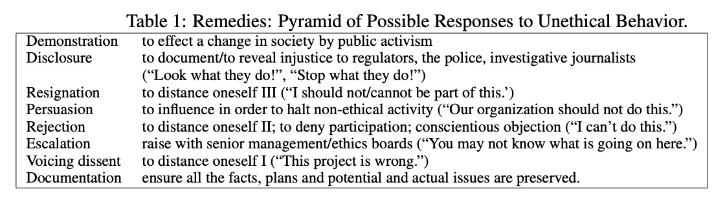
Education
Exclusion and demographic bias
Overgeneralization and confirmation bias
Topic overexposure (availability heuristic) and underexposure
http://aclweb.org/anthology/P16-2096
NLP ethical best practices http://aclweb.org/anthology/W17-1604.pdf

Slide 19
Education
Consider: “dual-use” technologies
Technologies designed for civilian use but which may have military applications
Google’s Project Maven, software for automated drone surveillance for the Pentagon
Microsoft employees have protested the company’s involvement in the same Department of Defense program
Amazon’s collaboration with the US Immigration and Customs Enforcement (ICE)

Slide 20
Education
Codes of Ethics
Some have advocated for a “Data Science Hippocratic Oath”
IEEE and ACM organizations have explicit codes of ethics
AI research is arguably unique, but NeurIPS 2018 has a Code of Conduct and the ML Ally Pledge is similarly well constructed
Many other institutions and “influencing” organizations have begun making their own

Slide 21
Communication
Potential misuses and ethical considerations of new AI and data science algorithms / packages are rarely identified and pointed out, either in documentation or in academic papers
Amazon’s Rekognition product for facial recognition did not warn about the high false positive rate associated with its default parameters

Slide 22
Communication
New “Ethical Considerations” section in published works (academic, code documentation, blog posts, etc)
Margaret Mitchell, former head of Google Research and Machine Intelligence at Google
2017 paper flagging patient suicide risk in clinical settings given their writings as input
Point out clear cases of potential ethical mis-use and how their study mitigated these concerns

Slide 23
Communication
Standardizing means of communicating aspects of new datasets and AI services
Datasheets for datasets
Data statements for NLP
Policy certificates for RL
Declarations of AI service conformity

Slide 24
Distribution
Approval and Terms of Access for datasets, code, and models
ImageNet
One of the most important computer vision datasets of the decade
Downloading it requires agreeing to terms of access!
Admittedly increases overhead for host lab or organization, but helps mitigate the dual-use problem
A “Responsible AI License” for code and pre-trained models

Slide 25
Distribution

Slide 26
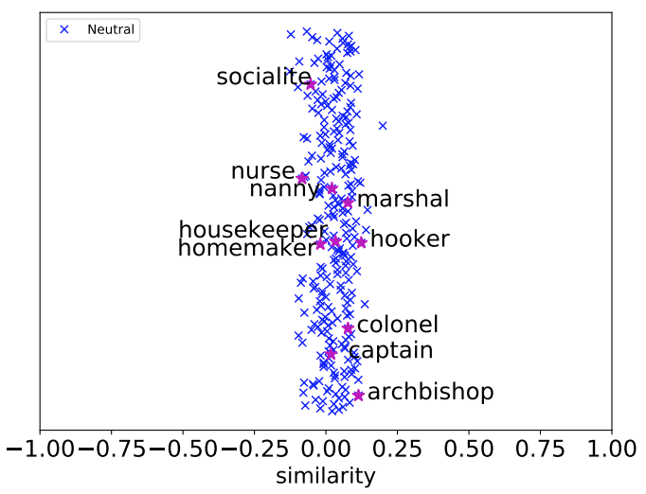
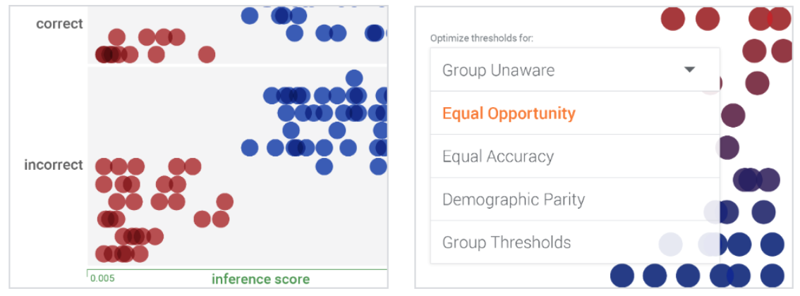
Distribution
Use, share, and create emerging tools to detect bias and explore datasets for ethical considerations
IBM’s AI Fairness 360
Google’s What-If
gn_glove, a gender- neutral word2vec- like embedding
https://pair-code.github.io/what-if-tool/
https://www.ibm.com/blogs/research/2018/09/ai-fairness-360/
https://arxiv.org/pdf/1809.01496.pdf

Slide 27
Advocacy
This is where we ALL come in
Bring up concerns in talks and classrooms (like this one!)
Dedicate part of the syllabus (like this one)
Take an entire class on AI and Ethics, Ethics and Philosophy, Human Computer Interaction (HCI)
Image from one of Stanford AI Lab’s ‘AI Salon’ events on Best Practices in doing Ethical AI Research

Slide 28
Advocacy
Obtain and promote more diverse research perspectives
In 2017, Joy Buolamwini found facial recognition platforms at Microsoft, IBM, and Face++ did very poorly when identifying women and minorities

Slide 29
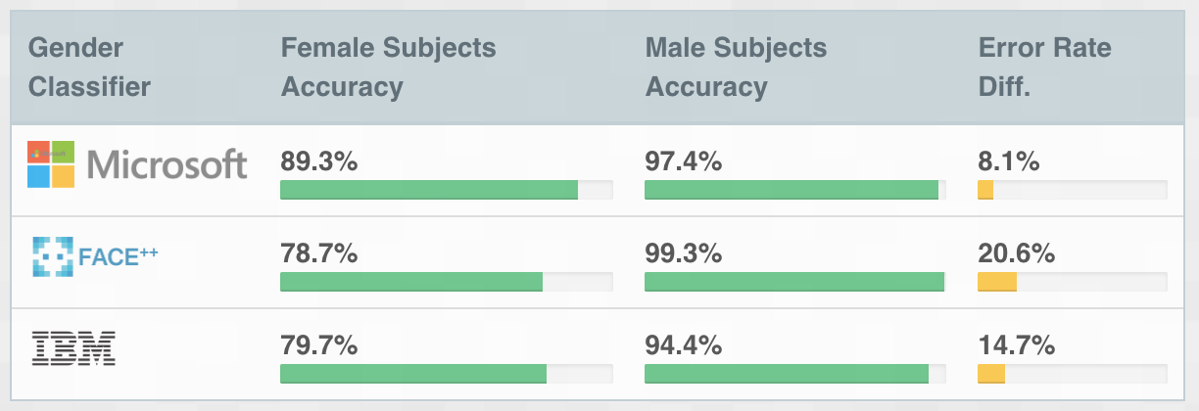
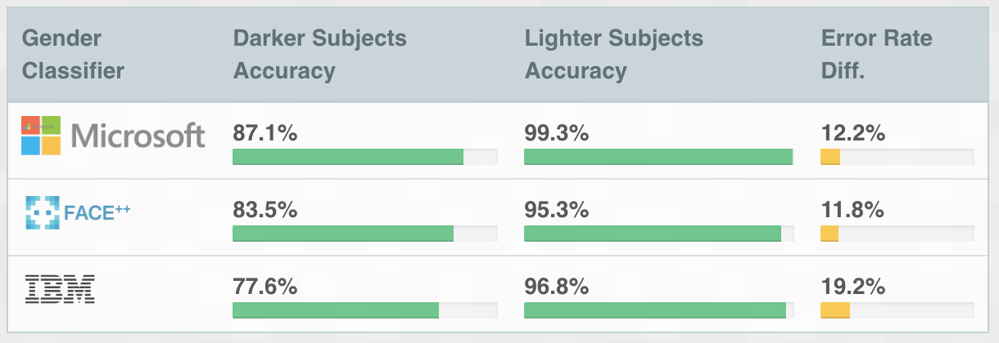
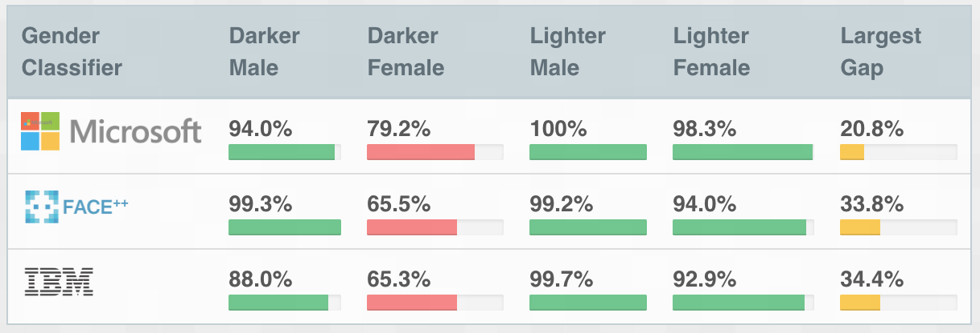
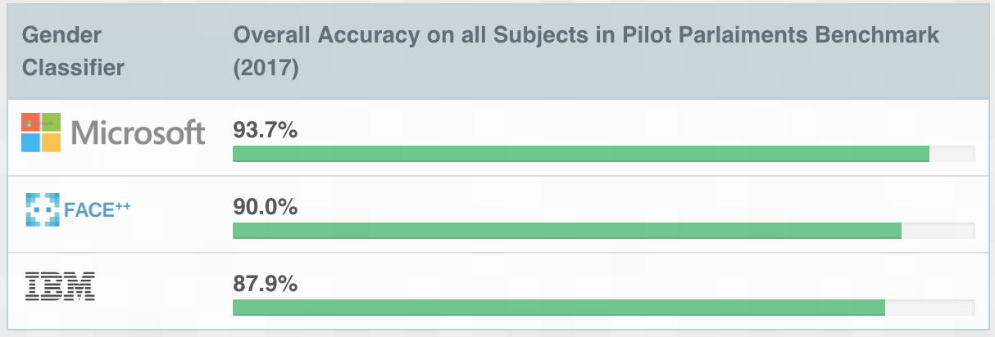
Advocacy
While each service touted an excellent overall accuracy, certain subgroups performed very poorly
She created http://gendershades.org/ and contacted each company regarding their inclusion and diversity practices during development

Slide 30
Advocacy
Small and large-scale initiatives
AI4ALL
Women in AI
Black in AI
AI Now and NYU
Human-Centered AI Institute at Stanford
Ada Lovelace Institute
AAAI/ACM Conference on AI, Ethics, and Society

Slide 31
Advocacy
And don’t forget: you
Take a stand against unethical decisions
Employees of Amazon and Microsoft have likewise worked to withdraw their respective companies from DoD contracts
Expand your own intellectual and research circles to include other viewpoints
Notes:
Differentiate hype from reality
Weigh effects of AI *now* vs distant, half-formed possibilities later

Slide 32
Conclusions
Data science and artificial intelligence are only going to become more intertwined with our daily lives (self-driving cars, smart homes, internet-of-things)
Automated decision-making has the potential to shape our civilization on a large scale
Understanding this technology and the strengths and limitations of its abilities is critical as we integrate it ever more deeply into our everyday routines
Being able to interface not only with researchers, but with policymakers, legislators, and the public is going to be essential
Can no longer afford to hide behind the ivory tower and ignore the implications of our work, and its unintended consequences

Slide 33
References
Slides https://thegradient.pub/in-favor-of-developing-ethical-best-practices-in-ai-research/
Gender Shades http://gendershades.org/index.html
Stanford Sexual Orientation https://www.nytimes.com/2017/10/09/science/stanford-sexual-orientation-study.html
Amazon Rekognition https://www.nytimes.com/2019/01/24/technology/amazon-facial-technology-study.html
ACM FAccT Proceedings https://facctconference.org/
AI Ethics Resources https://www.fast.ai/2018/09/24/ai-ethics-resources/

Slide 34
Questions?

